Slide 1
COMP 2710 Software Construction
Project 1 - Use Case Analysis
Dr. Xiao Qin
Auburn University
http://www.eng.auburn.edu/~xqin
xqin@auburn.edu
Spring, 2012
1-<number>

Slide 2
Topics
Use case specification – template:
  The behavior of a use case.
How to use ArgoUML
  Use case diagram
  Use case specification
  Data flow diagram
Project 1 – Example.
1-<number>

Slide 3
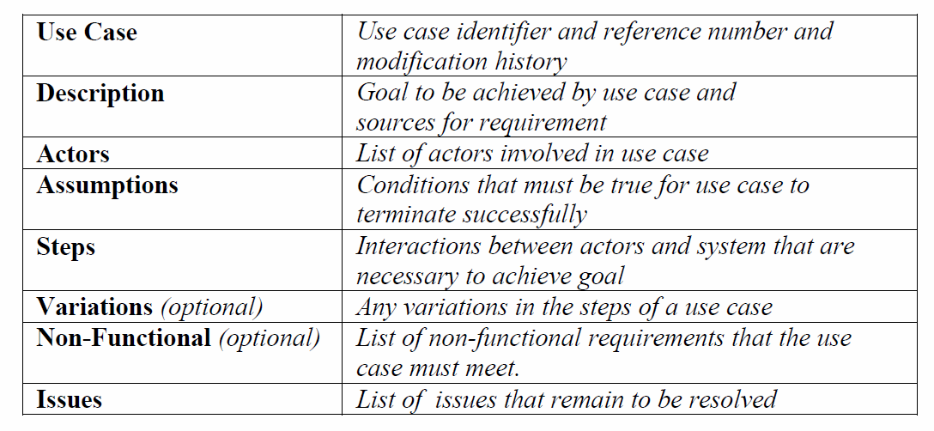
Use Case Template
Reference: http://www.bredemeyer.com/pdf_files/use_case.pdf
1-<number>
Notes:
See also: A Use Case Template.pdf

Slide 4
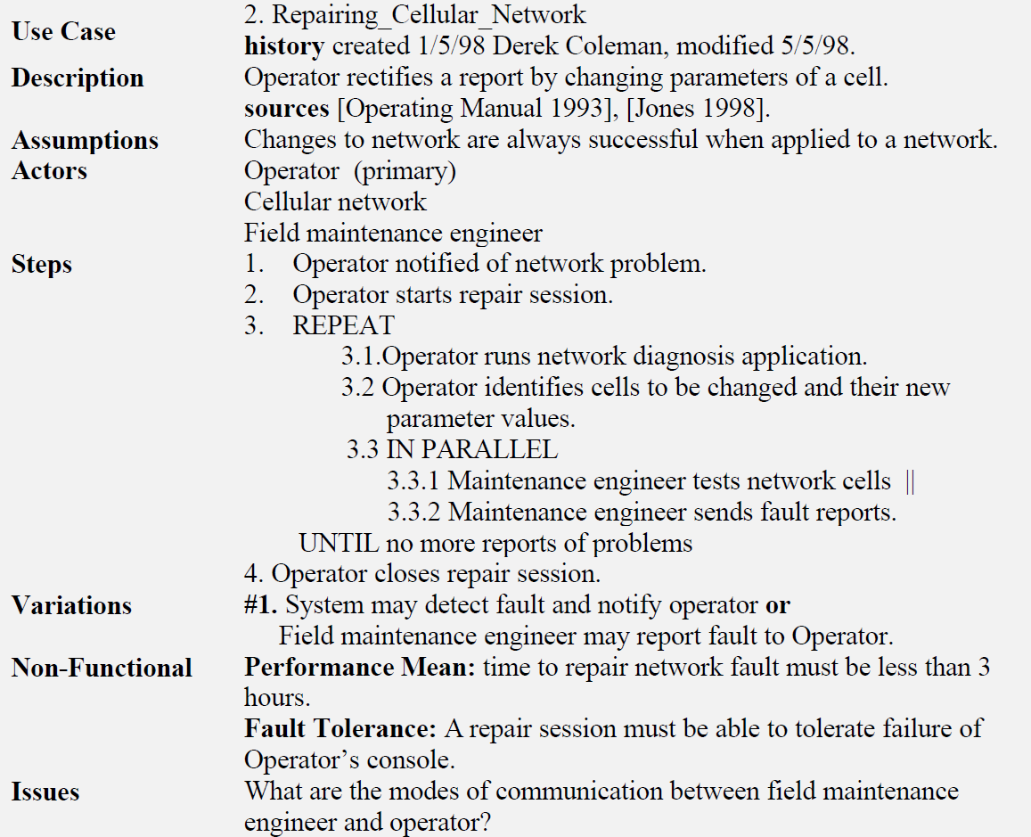
Use Case – An Example
1-<number>
Notes:
See also: A Use Case Template.pdf
The example below shows a use case that describes the interactions involved in repairing a cellular
network. The business goal of the (primary) actor the Operator is to repair the network. The other active
participants are the cellular network itself and a field maintenance engineer. The source information for the
use case comes from two sources viz. Operating Manual [1993] and [Jones 1998]. In order for the use case
to succeed it is assumed that any changes that are sent to the cellular network will not fail. That is the
network cells will change as directed.

Slide 5
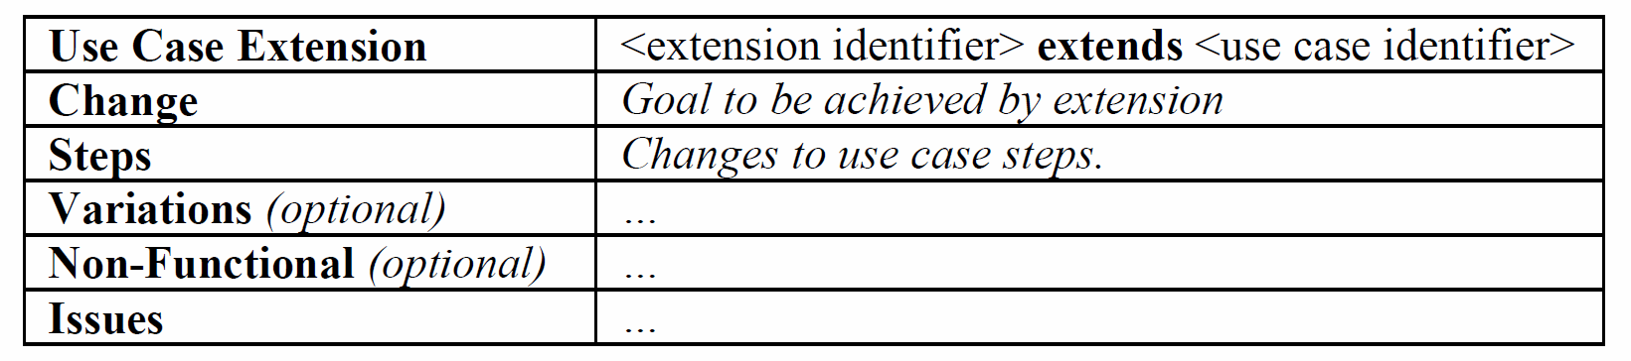
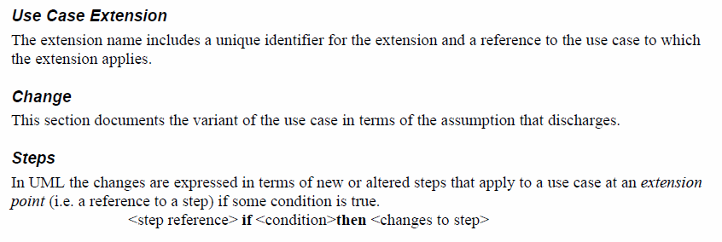
Extending a Use Case
Reference: http://www.bredemeyer.com/pdf_files/use_case.pdf
1-<number>
Notes:
See also: A Use Case Template.pdf

Slide 6
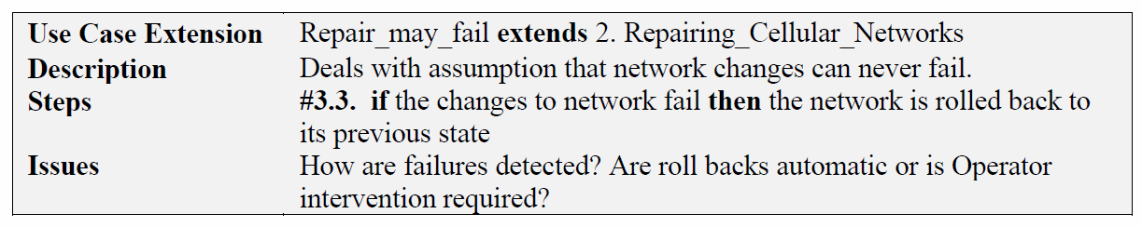
Extending a Use Case – An example
1-<number>
Notes:
See also: A Use Case Template.pdf

Slide 7
Demo: How to use ArgoUML?
1-<number>

Slide 8
Project 1: Use Case Analysis
1-<number>
Notes:
12 use cases
6 pages
Font size 12
Single space
Actors: sys admin, branch staff

Slide 9

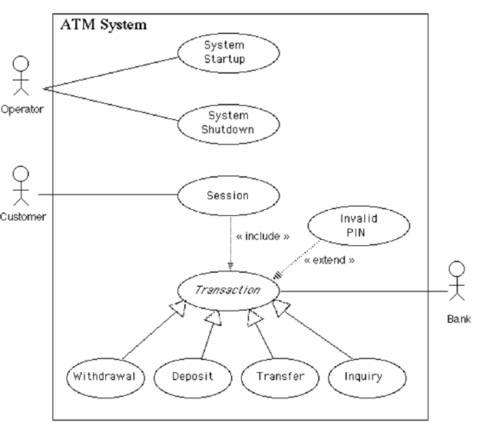
Use Case - Exercise
1-<number>

Slide 10
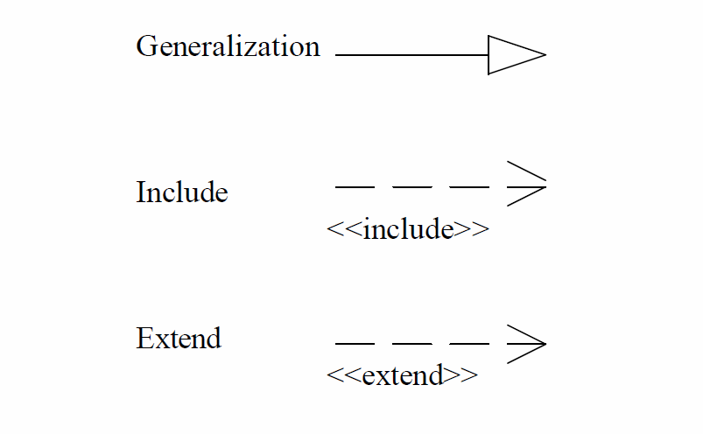
Summary
Use Cases describe the behavioral aspects of the system.
Use cases are not design tools.
Use Cases are a convenient way to document the functions that the system must support.
Use Cases are used to identify the components (classes) of the system.
Use case relationships?
1-<number>
Notes:
Why use cases are not design tools? - Just functional descriptions not software structure.

